Slide 1
Galileo ELD Department
ELD Team-Building Activity
(Getting to know Galileo)

Slide 2
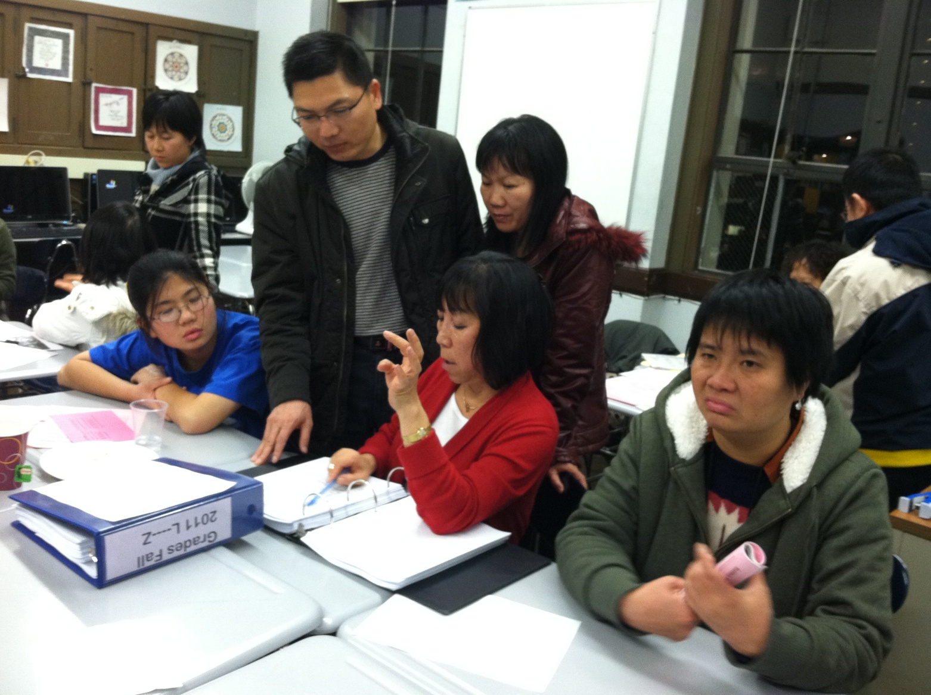
ELAC MEETING NIGHT

Slide 3
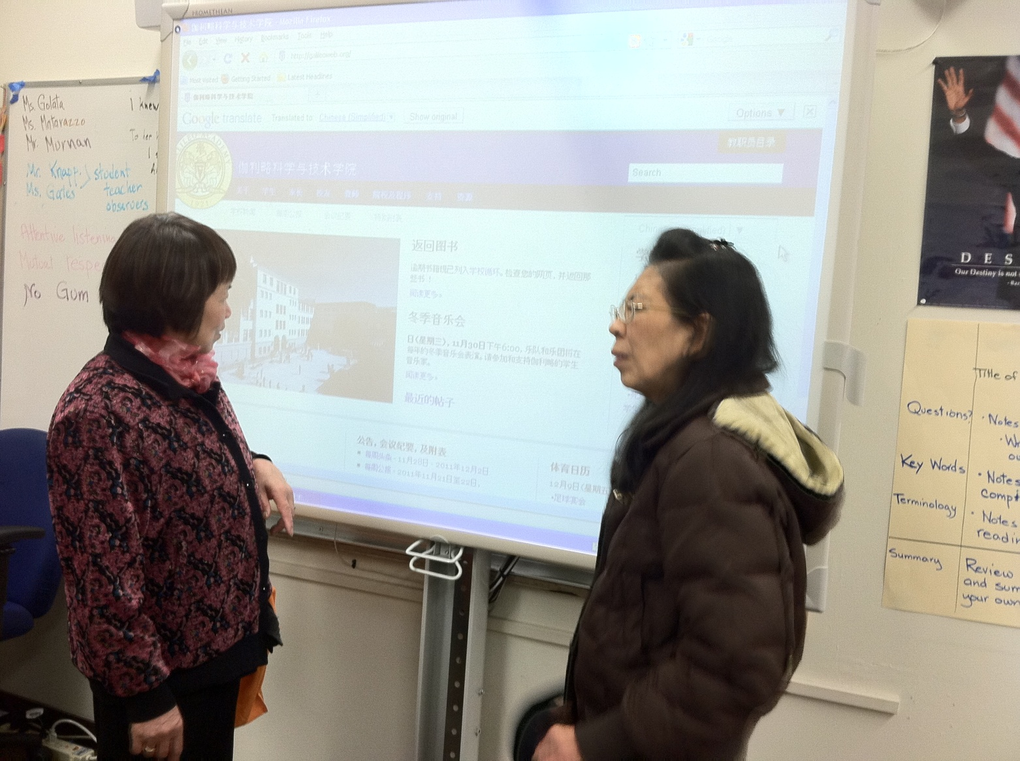
Elac meeting-parents

Slide 4
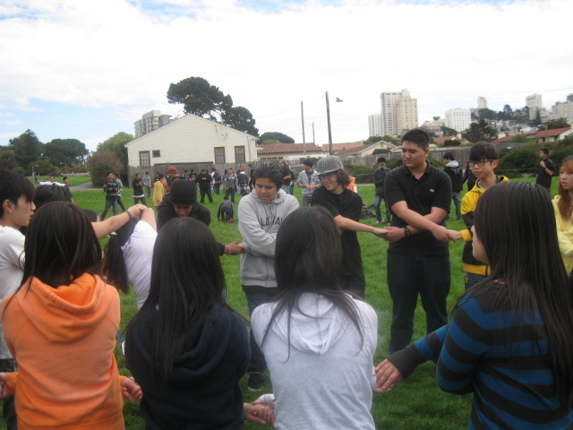
Eld team-building Games

Slide 5
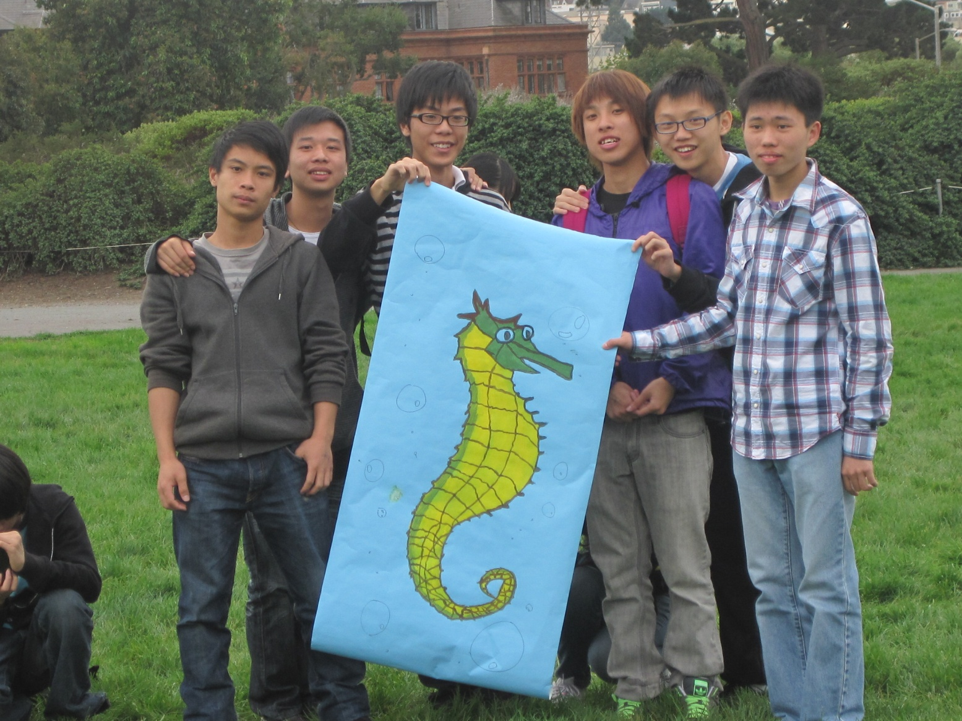
All students were divided into teams for competitions

Slide 6
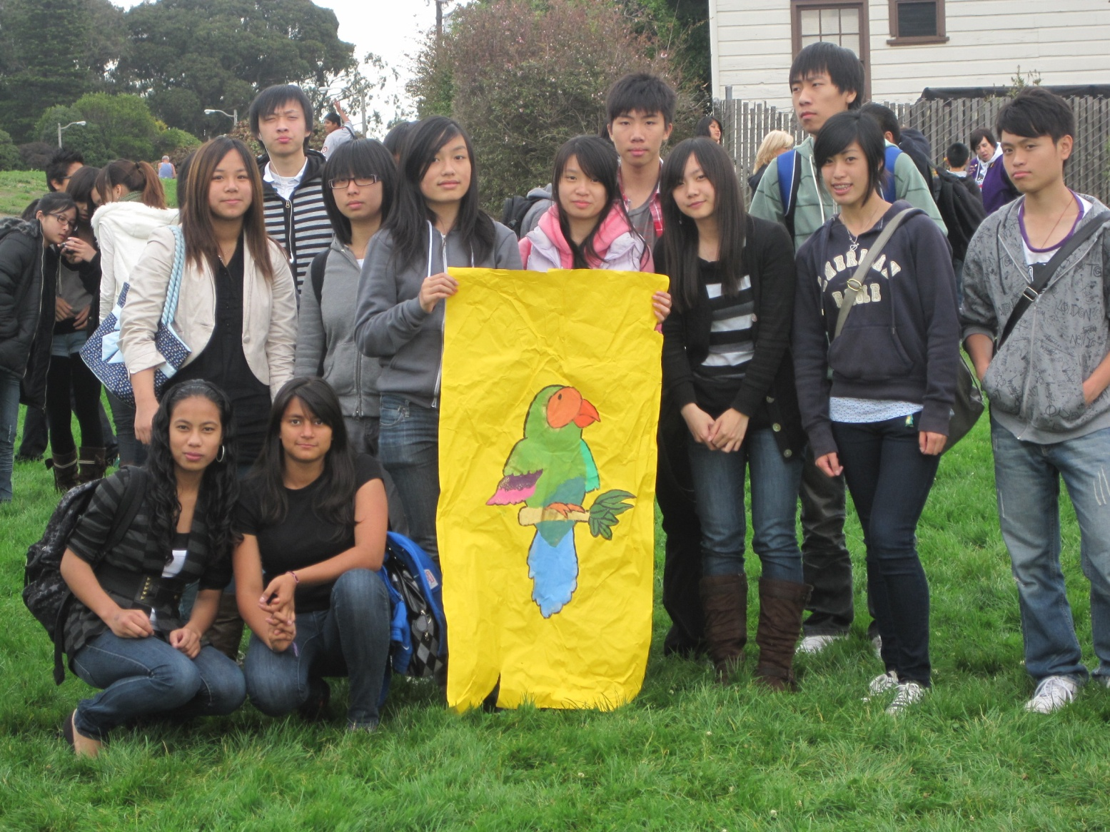
Learning and getting to know each other and their teachers

Slide 7
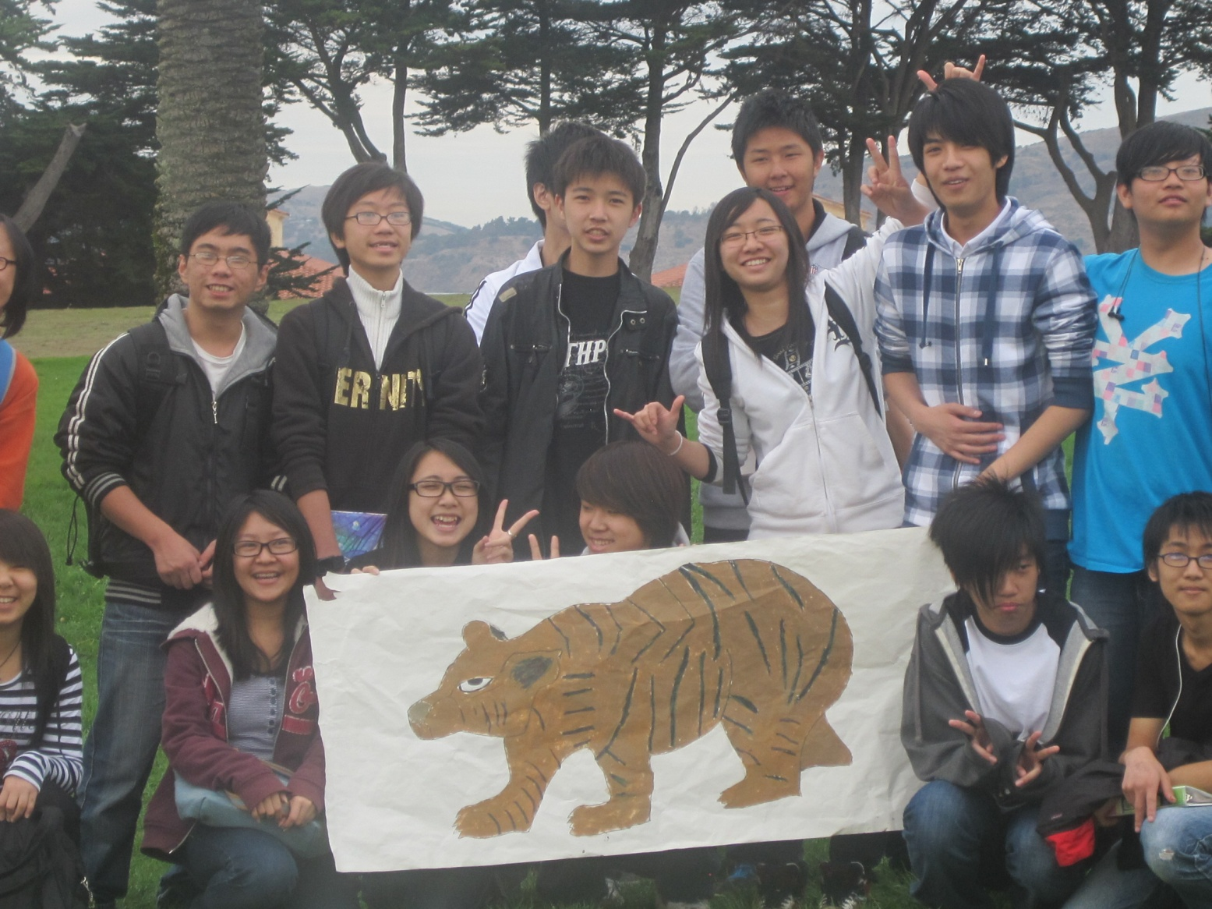
Everyone had fun!!

Slide 8
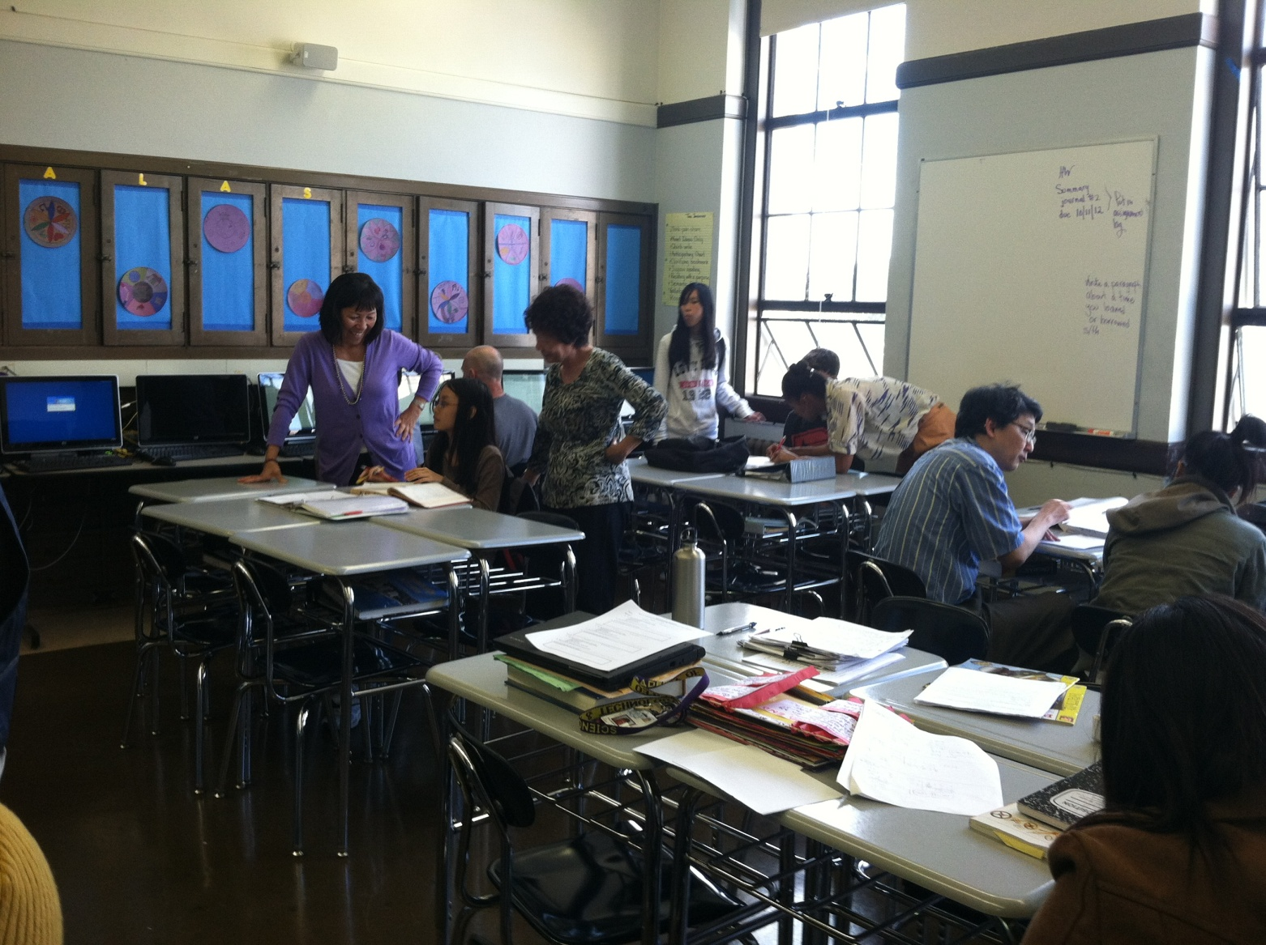
Tutoring-ms.Lau & ms.lu

Slide 9
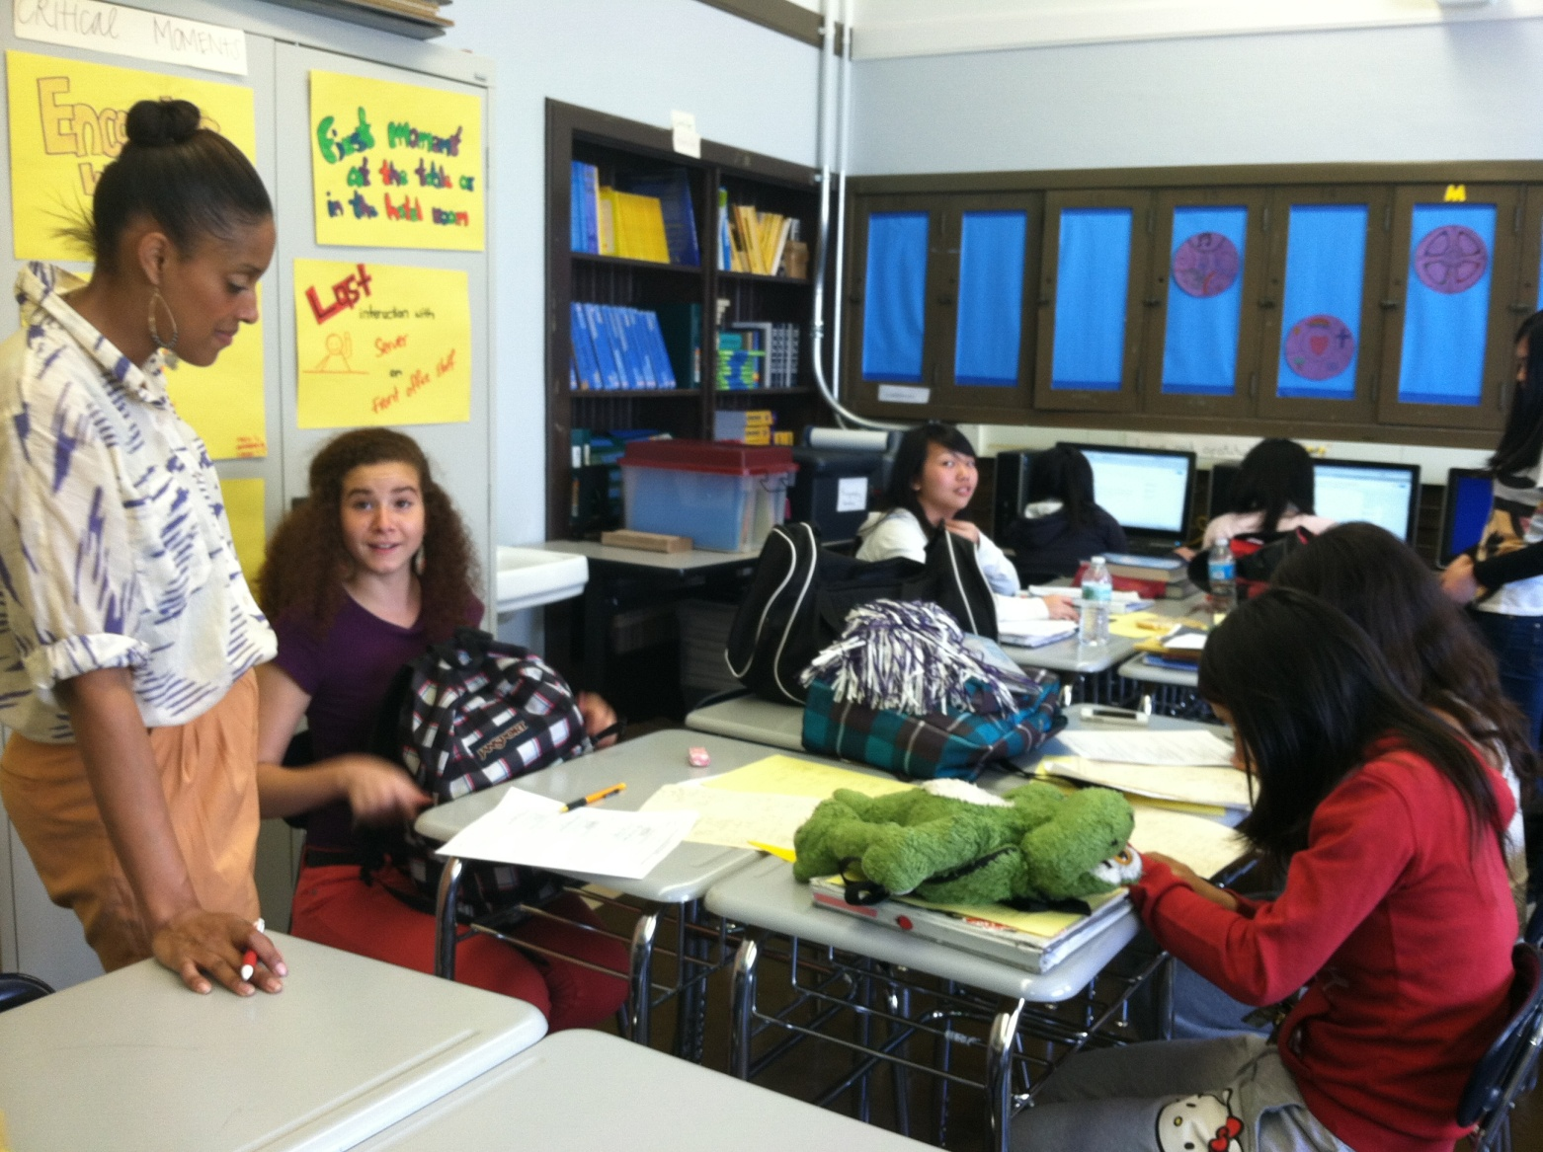
Tutoring – Ms. Carter

Slide 10
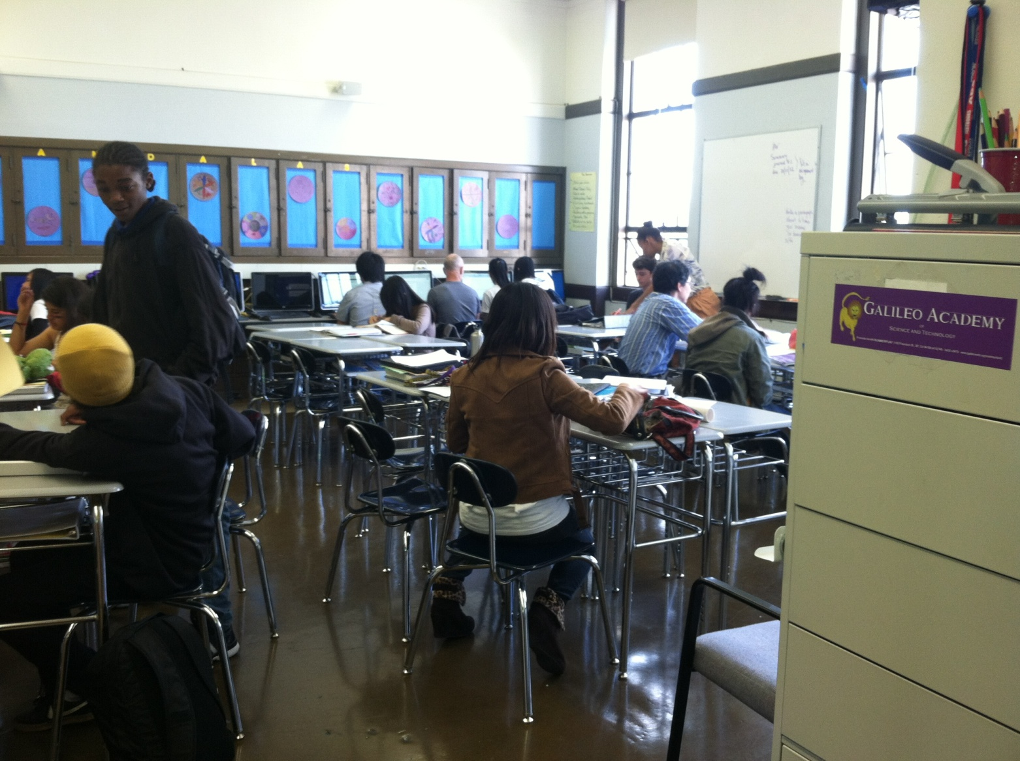
After school Tutoring

Slide 11
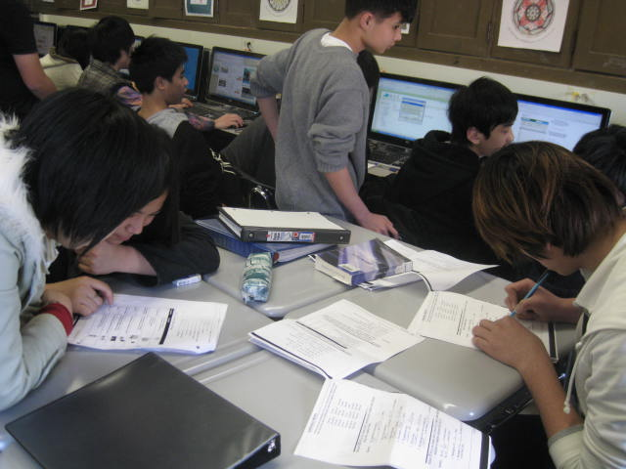
Tutoring—english learner

Slide 12
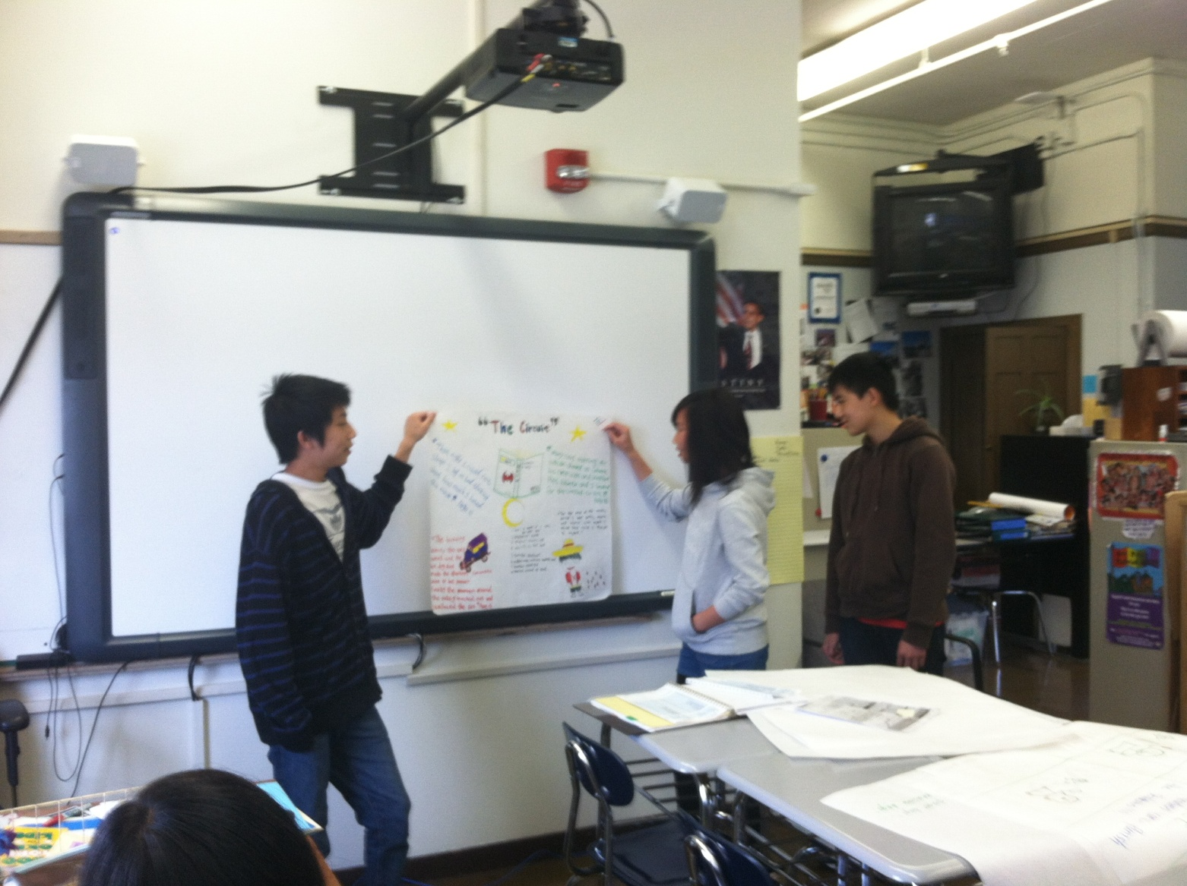
Reading 3 classroom

Slide 13
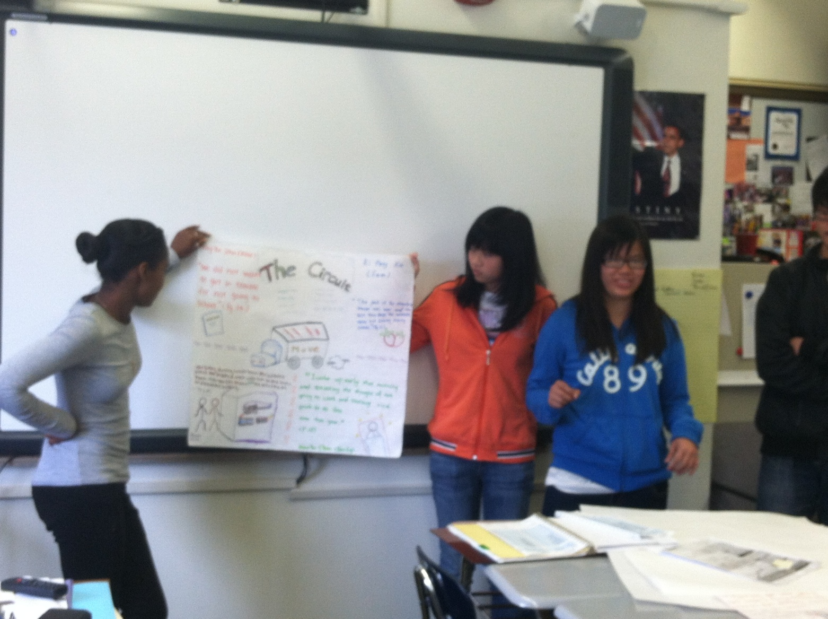
Student presentation

Slide 14
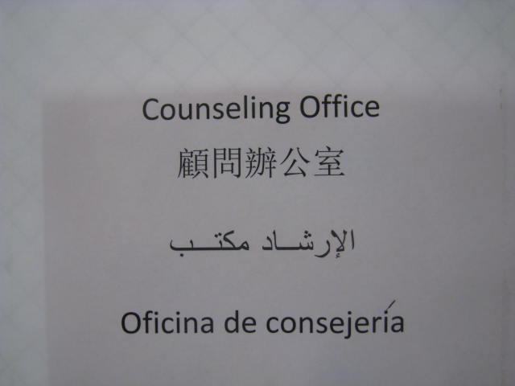
Trilingual sign made by Newcomer Mentors

Slide 15
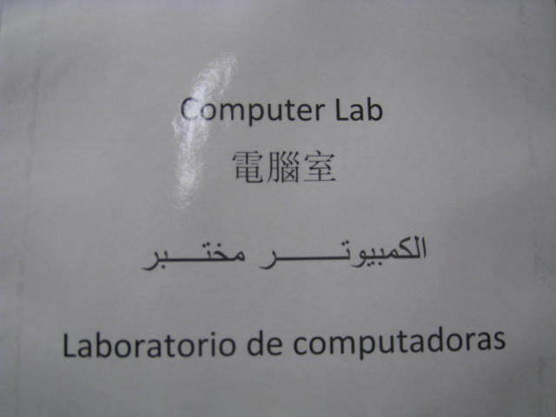
Trilingual sign made by Newcomer Mentors

